Slide 1
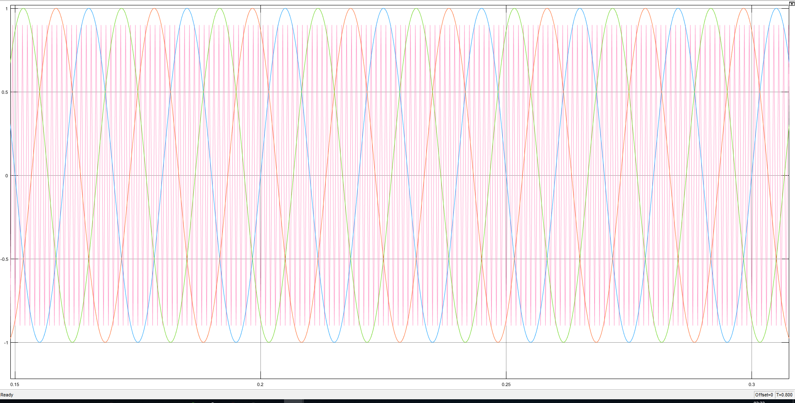
Triangular and Sinusoidal Pwm input

Slide 2
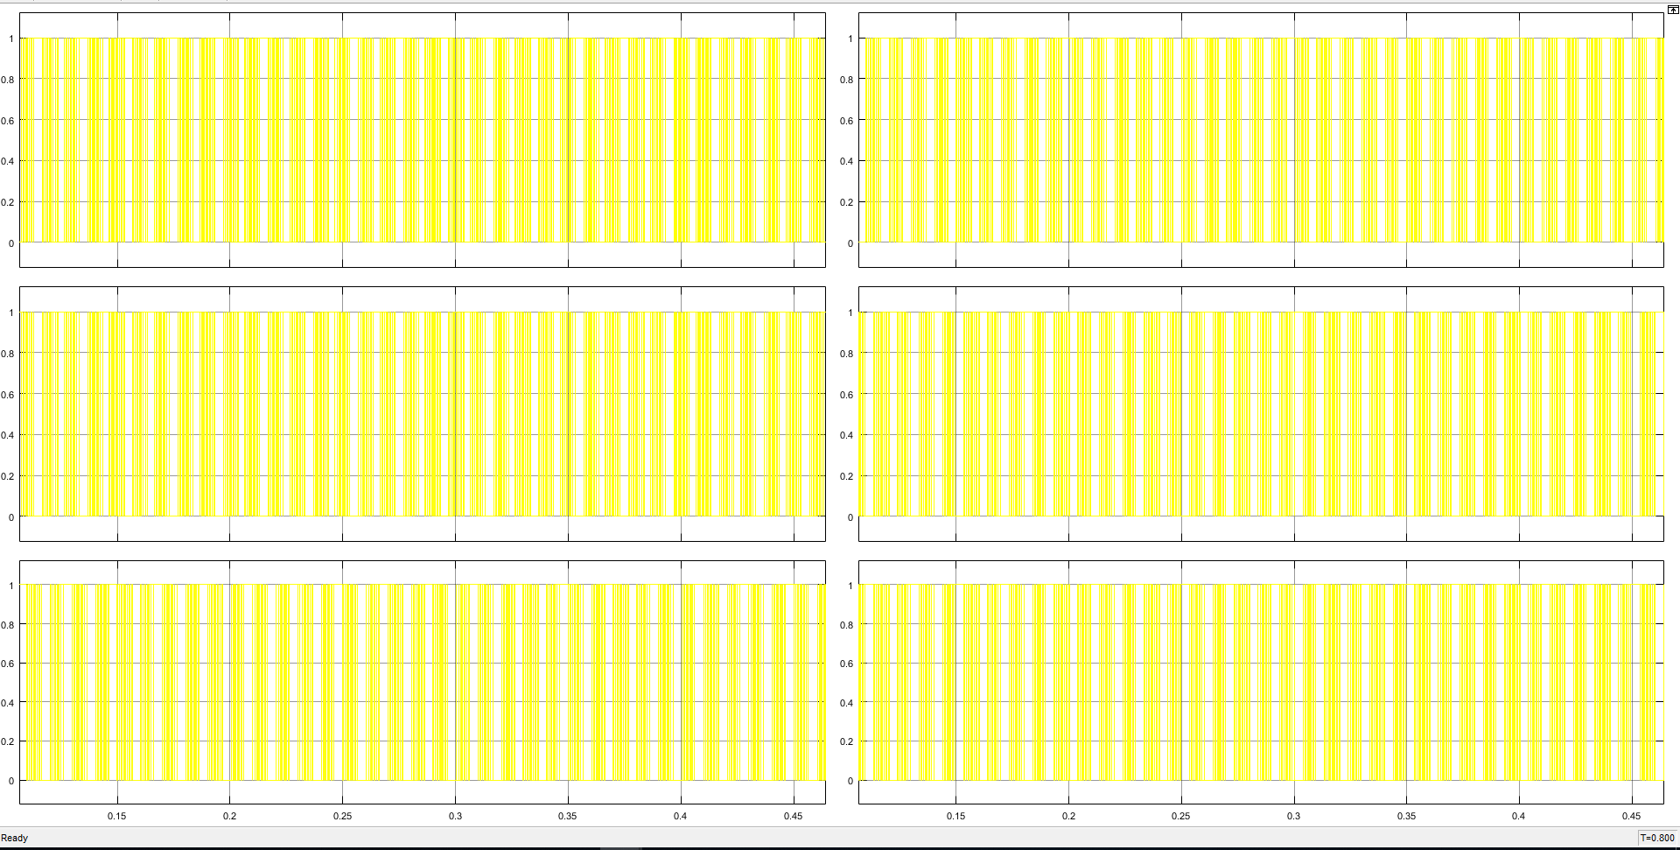
PWM

Slide 3
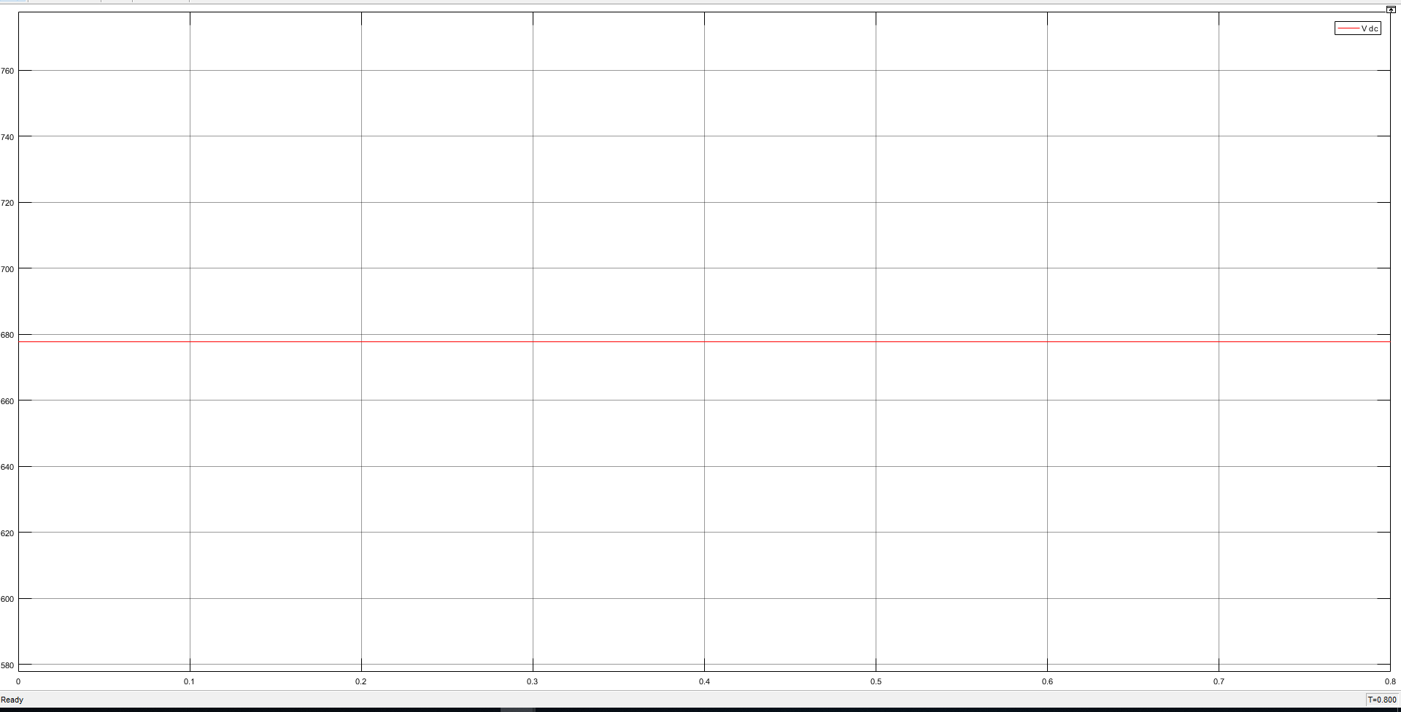
DC Input

Slide 4
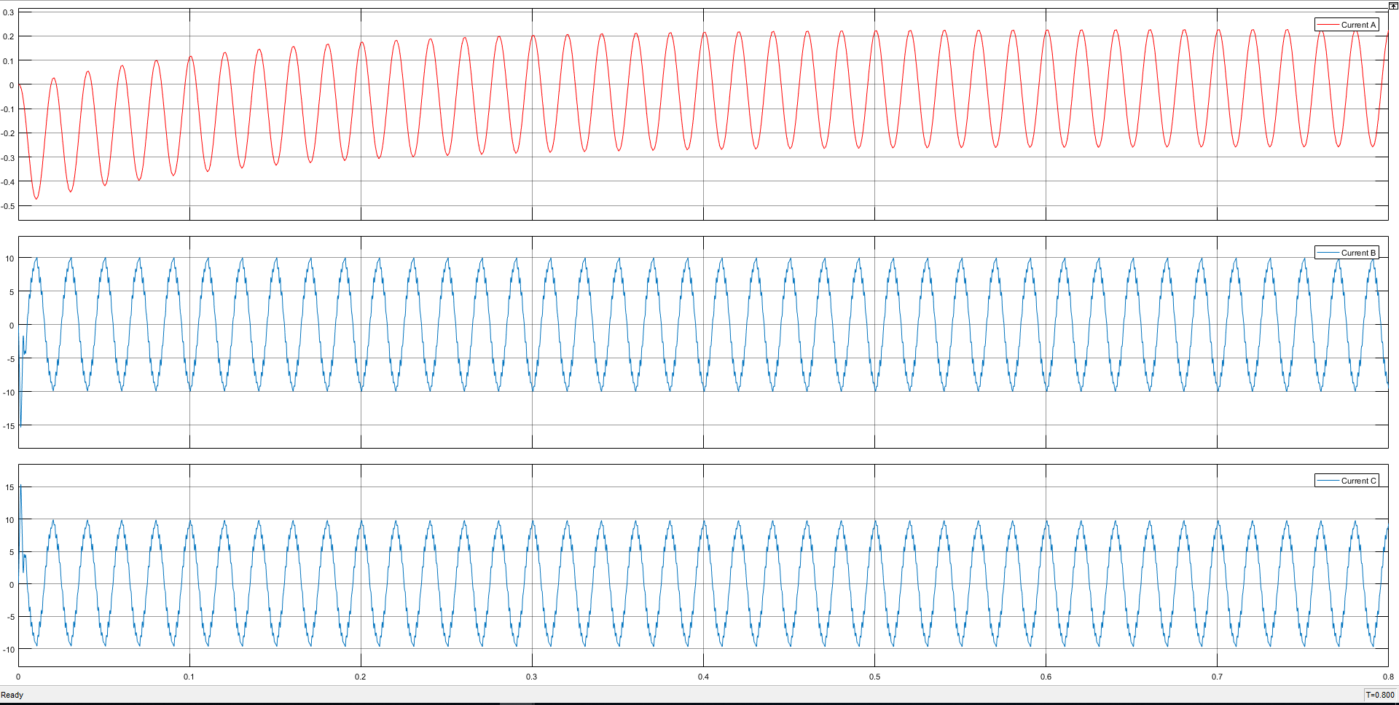
Current Waveform for Phase

Slide 5
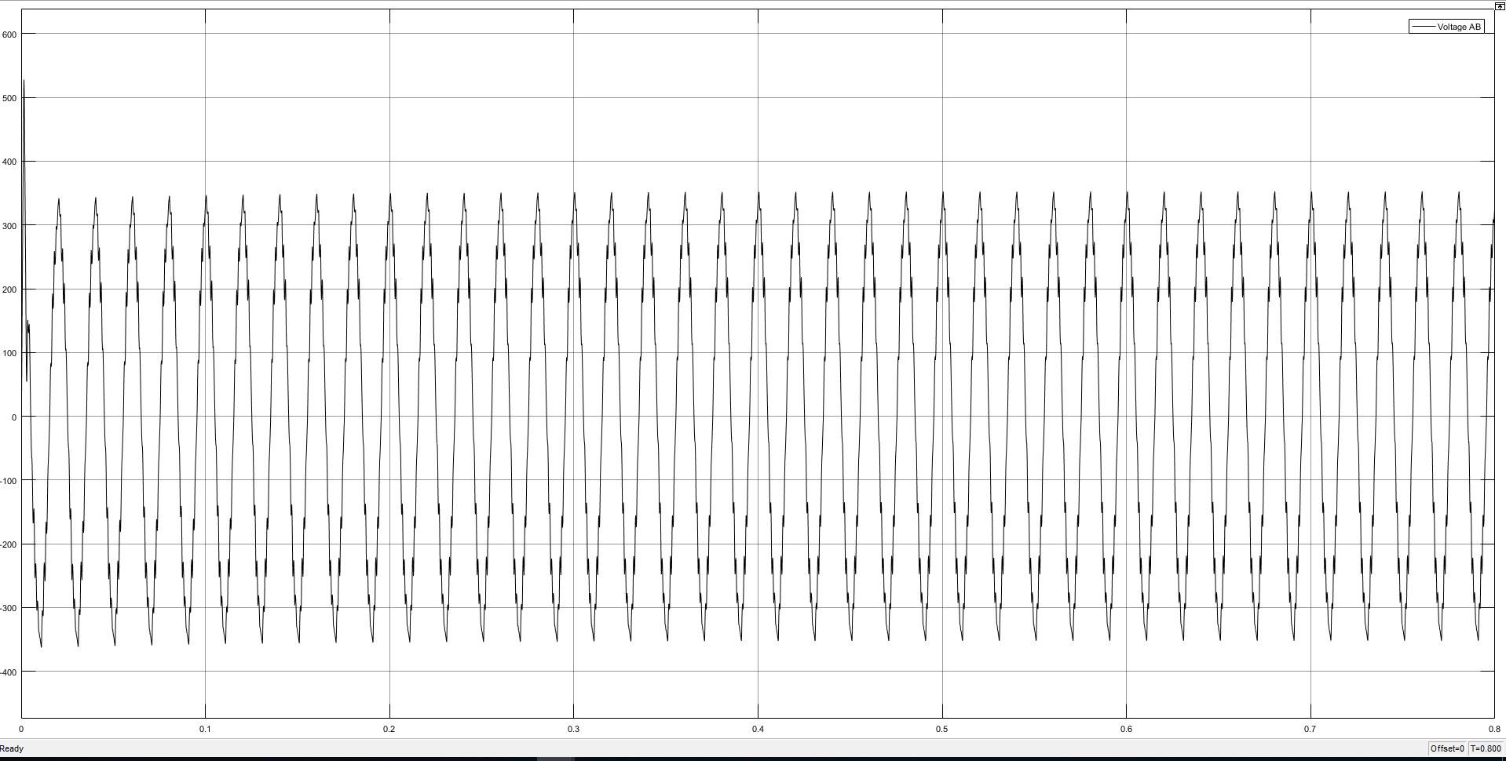
Voltage Waveform for line-to-line

